Slide 1

Deep Dive
Training your first neural network with Tensorflow
Mark Schutera @Night

Slide 2


Have programmed something in Python before?

Slide 3
Have you trained a neural network before?

Slide 4
Have you heard of Tensorflow?

Slide 5
Have you used Tensorflow?

Slide 6
Do you understand the concepts of Deep Learning?

Slide 7
How this lecture will look like
😍 Smiling Face with Heart-Eyes
Binder is up and running
5 minutes
🙃 Upside-Down Face
You know how to navigate through jupyter notebook and basic python
10 minutes
😅 Grinning Face with Sweat
You did load the MNIST data, designed a model architecture and compiled your model for training
25 minutes
😆 Grinning Squinting Face
You did train your model and did start reading into validation
15 minutes
😇 Smiling Face with Halo
You did validate your model with two approaches
15 minutes

Slide 8
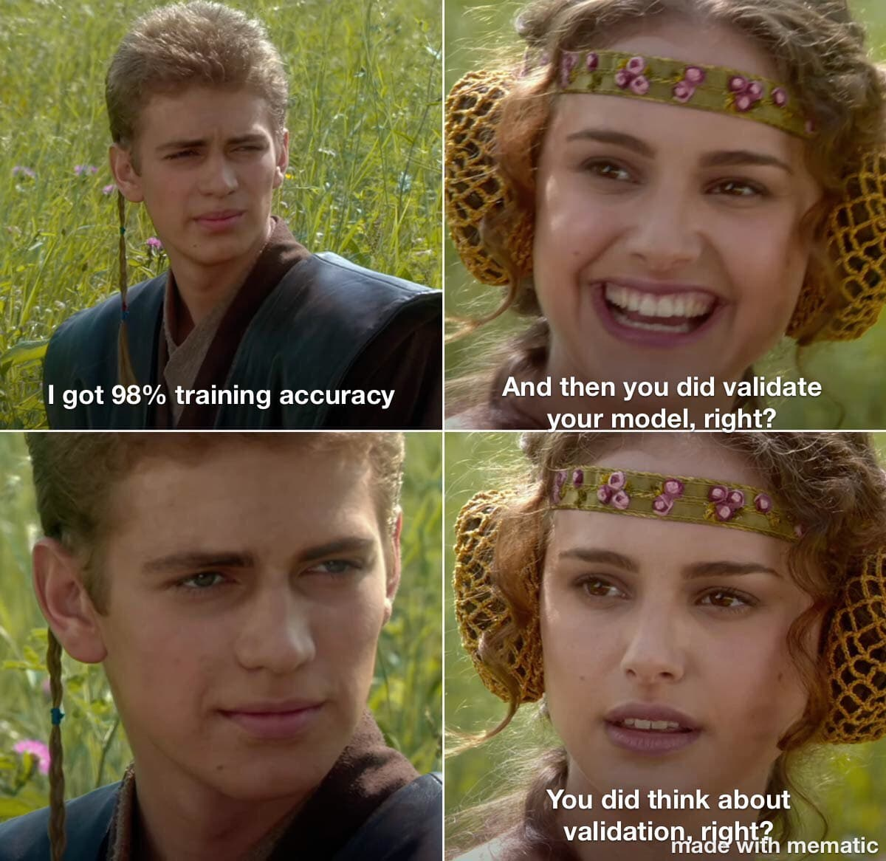
If there is time I will talk about the pivotal role of validation in deep learning for perception

Slide 9
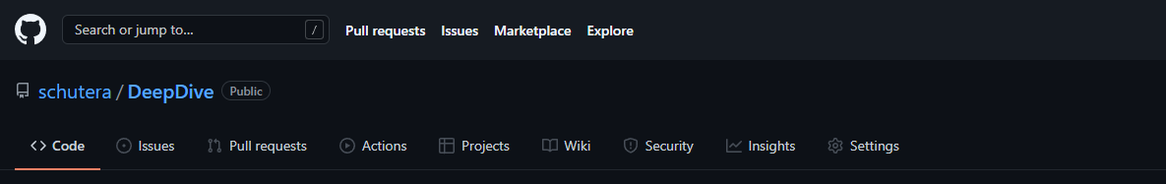

https://github.com/schutera/DeepDive
I will be in the chat so reach out through direct message.
Notes:
This is where the solutions live:
TheseAreNotTheSolutionsYouAreLookingFor.ipynb

Slide 10
How this lecture will look like
😍 Smiling Face with Heart-Eyes
Binder is up and running
5 minutes
🙃 Upside-Down Face
You know how to navigate through jupyter notebook and basic python
10 minutes
😅 Grinning Face with Sweat
You did load the MNIST data, designed a model architecture and compiled your model for training
25 minutes
😆 Grinning Squinting Face
You did train your model and did start reading into validation
15 minutes
😇 Smiling Face with Halo
You did validate your model with two approaches
15 minutes

Slide 11
How this lecture will look like
😍 Smiling Face with Heart-Eyes
Binder is up and running
5 minutes
🙃 Upside-Down Face
You know how to navigate through jupyter notebook and basic python
10 minutes
😅 Grinning Face with Sweat
You did load the MNIST data, designed a model architecture and compiled your model for training
25 minutes
😆 Grinning Squinting Face
You did train your model and did start reading into validation
15 minutes
😇 Smiling Face with Halo
You did validate your model with two approaches
15 minutes

Slide 12
How this lecture will look like
😍 Smiling Face with Heart-Eyes
Binder is up and running
5 minutes
🙃 Upside-Down Face
You know how to navigate through jupyter notebook and basic python
10 minutes
😅 Grinning Face with Sweat
You did load the MNIST data, designed a model architecture and compiled your model for training
25 minutes
😆 Grinning Squinting Face
You did train your model and did start reading into validation
15 minutes
😇 Smiling Face with Halo
You did validate your model with two approaches
15 minutes

Slide 13
How this lecture will look like
😍 Smiling Face with Heart-Eyes
Binder is up and running
5 minutes
🙃 Upside-Down Face
You know how to navigate through jupyter notebook and basic python
10 minutes
😅 Grinning Face with Sweat
You did load the MNIST data, designed a model architecture and compiled your model for training
25 minutes
😆 Grinning Squinting Face
You did train your model and did start reading into validation
15 minutes
😇 Smiling Face with Halo
You did validate your model with two approaches
15 minutes

Slide 14
How this lecture will look like
😍 Smiling Face with Heart-Eyes
Binder is up and running
5 minutes
🙃 Upside-Down Face
You know how to navigate through jupyter notebook and basic python
10 minutes
😅 Grinning Face with Sweat
You did load the MNIST data, designed a model architecture and compiled your model for training
25 minutes
😆 Grinning Squinting Face
You did train your model and did start reading into validation
15 minutes
😇 Smiling Face with Halo
You did validate your model with two approaches
15 minutes

Slide 15
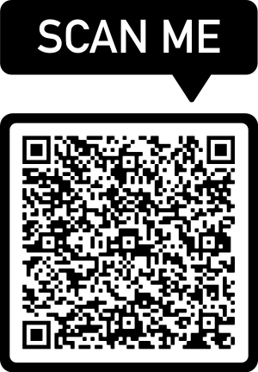
You want to reach out?

Slide 16


Mum, Machine Learning breaks my safety process
How does Deep Learning work in general?
What is 3+5?
A Developer / Model Dialogue in 7 lines
6
No, please try again.
Training
7
What the heck dude.
8
Oh my god, it is intelligent!
Mark Schutera @Night

Slide 17
Mum, Machine Learning breaks my safety process
So why is this so hard to validate?
8
Potential to overfit on data seen during training.
This makes gaps in the training and validation data critical.
Oh my god, it is intelligent!
Validation
What is 3+4?
8
Are you kidding me?
Mark Schutera @Night

Slide 18
Mum, Machine Learning breaks my safety process
So why is this so hard to validate?
Potential to overfit on data seen during training.
This makes gaps in the training data critical. Further it is hard to validate behavior on potentially infinite unseen samples (unknown unknowns).
What is 1-2?
Deployment
97
.. seriously?
Mark Schutera @Night

Slide 19

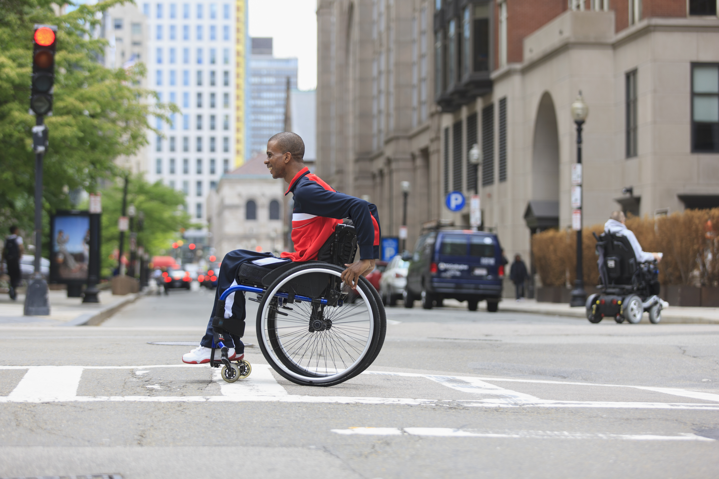
AI Biases and why it is so hard to not fall for them
In the following we assume an object detector trained on instances of vehicles and pedestrians
Introducing bias an incomplete list
1
Task Framing
Objective Function
Vehicle or Pedestrian?
A model will answer what you ask
2
3
Data sampling
4
Validation Bias
5
Social context
Mark Schutera @Night
Notes:
Task Framing: Dog, Cat, Tiger – is this person a criminal?

Slide 20
AI Biases and why it is so hard to not fall for them
In the following we assume an object detector trained on instances of vehicles and pedestrians
Introducing bias an incomplete list
1
Task Framing
Please detect objects
Unintended behavior and when the model decides vehicles are enough
2
Objective Function
3
Data sampling
4
Validation Bias
5
Social context
Mark Schutera @Night
Notes:
Objective Function: How do we define success?„Safety“
Driving up tight is supposed to be bad – but then we have cut ins.
Recall vs Precision.
In segmentation collapse to all black when segment is small.
Unbalanced data…

Slide 21
AI Biases and why it is so hard to not fall for them
In the following we assume an object detector trained on instances of vehicles and pedestrians
Introducing bias an incomplete list
1
Task Framing
Objective Function
Take my data
Influences performance and reinforces existing patterns
2
3
Data sampling
4
Validation Bias
5
Social context
Mark Schutera @Night
Notes:
Dataset: Unbalanced (pedestrians vs vehicles), unrepresentative of the real world.
reflecting existing prejudice – no wheelchair drivers. Low performance on pedestrians.
reinforcing mechanisms (recommender systems, or deployed system)

Slide 22
AI Biases and why it is so hard to not fall for them
In the following we assume an object detector trained on instances of vehicles and pedestrians
Introducing bias an incomplete list
1
Task Framing
Unknown unknowns
What you train on is what you validate on, and metrics usually further promote the “vehicle are enough bias”.
2
Objective Function
3
Data sampling
4
Validation Bias
5
Social context
Mark Schutera @Night
Notes:
Validation: Usually we do a train, val, test split. However this just promotes the existing bias in the training data. As well as does not allow us to validate on unknown unknowns. Validation metrics become ambiguous. #ValidateOnWhatYouKnow
Vehicles are enough.

Slide 23
AI Biases and why it is so hard to not fall for them
In the following we assume an object detector trained on instances of vehicles and pedestrians
Introducing bias an incomplete list
1
Task Framing
Agree to disagree on what to focus on
Pedestrians are more vulnerable, vehicles are more frequent
2
Objective Function
3
Data sampling
4
Validation Bias
5
Social context
Mark Schutera @Night
Notes:
Social context: When trying to fix these biases, different societies will end up with different answers (ethics, fairness). These are not easy questions, but while we are great at coming up with yet another architecture for autonomous perception. We need to understand how we want our AI to be, before we can come up with technical solutions. This is where guidelines, regulatory processes enter the stage.
Iterative process, based on risk assessment – and no static end product.

Slide 24
Mum, Machine Learning breaks my safety process
Hard to prove? Why do we not use the tests we already have in place? Let’s talk about traditional validation concepts.
The V-Model
Design
Requirements
Concept
Deployment
Requirements and Architecture
System
Integration
Test
Verification
Detailed Design
Component
Mark Schutera @Night [3]

Slide 25

Mum, Machine Learning breaks my safety process
Traditionally you would say this is what a wheel chair driver looks like, there is a person with a head, and a torso, in a sitting position on a chair with wheels ..
The V-Model
Requirements and Architecture
Detailed Design
Mark Schutera @Night [3]
Notes:
There are no requirements (you need to detect humans, they have a torso, two legs, ..) and there is no traditional design (?) – yes, there is implicit requirements (these are 1000 samples of persons)

Slide 26



Mum, Machine Learning breaks my safety process
When using deep learning, this step sums up to
“Here are images of wheel chair drivers, go learn what it means to look like a wheel chair driver.”
The V-Model
When using Deep Learning Models
Requirements and Architecture
Detailed Design
Mark Schutera @Night [3]
Notes:
There are no requirements (you need to detect humans, they have a torso, two legs, ..) and there is no traditional design (?) – yes, there is implicit requirements (these are 1000 samples of persons)

Slide 27

Mum, Machine Learning breaks my safety process
When using deep learning, this step sums up to
“Here are images of wheel chair drivers, go learn what it means to look like a wheel chair driver.”
We just lost intentional design
Requirements and Architecture
Detailed Design
Mark Schutera @Night [3]
Notes:
There are no requirements (you need to detect humans, they have a torso, two legs, ..) and there is no traditional design (?) – yes, there is implicit requirements (these are 1000 samples of persons)

Slide 28
Mum, Machine Learning breaks my safety process
The point of the V-Model is that the tests on the right side correspond back to the left side.
This thing you meant to do, I can assure you that you did it.
Requirements and Architecture
System
Detailed Design
Component
Mark Schutera @Night [3]

Slide 29
Mum, Machine Learning breaks my safety process
The point of the V-Model is that the tests on the right side correspond back to the left side.
This thing you meant to do, I can assure you that you did it.
I have a test set so we can still validate right?
System
Component
Mark Schutera @Night [3]

Slide 30

Mum, Machine Learning breaks my safety process
The point of the V-Model is that the tests on the right side correspond back to the left side.
This thing you meant to do, I can assure you that you did it – on this test dataset.
But I do not know why exactly a specific sample failed, and above all my test set is not complete.
We just lost intentional validation
System
Component
Mark Schutera @Night [3]
Notes:
Yes to some extend, but how confident are you, that it learned what it should. And how confident are you that it will not break on the next sample.
Especially for unknown unknowns. For stuff that you did not think of in your data at all.

Slide 31

Mum, Machine Learning breaks my safety process
But I do not know why exactly a specific sample failed, and above all my test set is not complete.
Under deployment this system is likely to break.
Deployment
Mark Schutera @Night [3]
Notes:
(?) can‘t we do requirements for the test dataset? You mean to be able to do this thing? Let me generate an according test set and see.

Slide 32

Let’s read more!
[1] Ethics, Safety, and Autonomous Vehicles.
P. Koopman, B. Kuipers, W.H. Widen, M. Wolf,
Virtual Roundtable
[6] Road vehicles — Functional safety.
ISO 26262-1:2018
International Organization for Standardization
[2] ImageNet classification with deep convolutional neural networks.
A. Krizhevsky, I. Sutskever, G. E. Hinton,
Communications of the ACM
[7] Road vehicles — Safety of the intended functionality.
ISO/FDIS 21448
International Organization for Standardization
[8] Risk reduction of experimental autonomous vehicles: The safety-bag approach
M. Brini, P. Crubillé, B. Lussier, W. Schon
CARS 2016 4th International Workshop on Critical
Automotive Applications: Robustness & Safety
[3] V-Model Lifecycle Process Model.
IABG Ottobrunn
V-modell.iabg.de
[4] Driving to Safety – How many miles of driving would it take to demonstrate autonomous vehicle reliability?
N. Kalra, S. M. Paddock
RAND Corporation
[5] How stress variance in the automotive environment will affect a ‚true‘ value of the reliability demonstrated by acclerated testing.
A. Kleyner
Society of Automotive Engineers International
Mark Schutera @Night

